Slide 1
Summary of the experiments

Slide 2
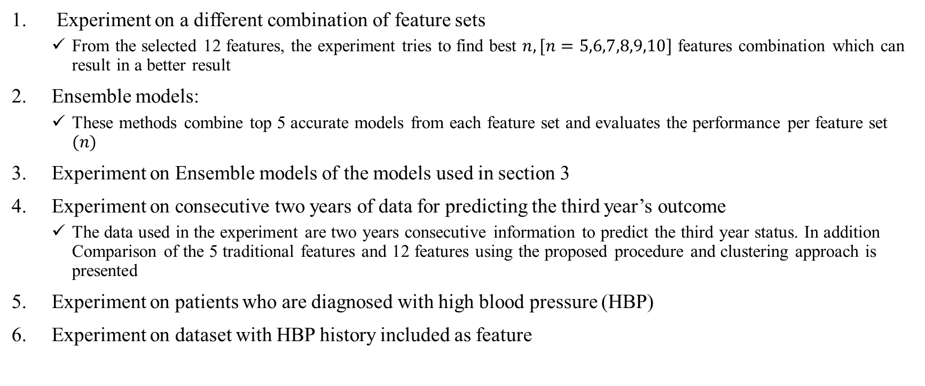
Content
Experiment on a different combination of feature sets
From the selected 12 features, the experiment tries to find best $n, [n=5,6,7,8,9,10]$ features combination which can result in a better result
Ensemble models:
These methods combine top 5 accurate models from each feature set and evaluates the performance per feature set $(n)$
Experiment on Ensemble models of the models used in section 3
Experiment on consecutive two years of data for predicting the third year’s outcome
The data used in the experiment are two years consecutive information to predict the third year status. In addition Comparison of the 5 traditional features and 12 features using the proposed procedure and clustering approach is presented
Experiment on patients who are diagnosed with high blood pressure (HBP)
Experiment on dataset with HBP history included as feature

Slide 3
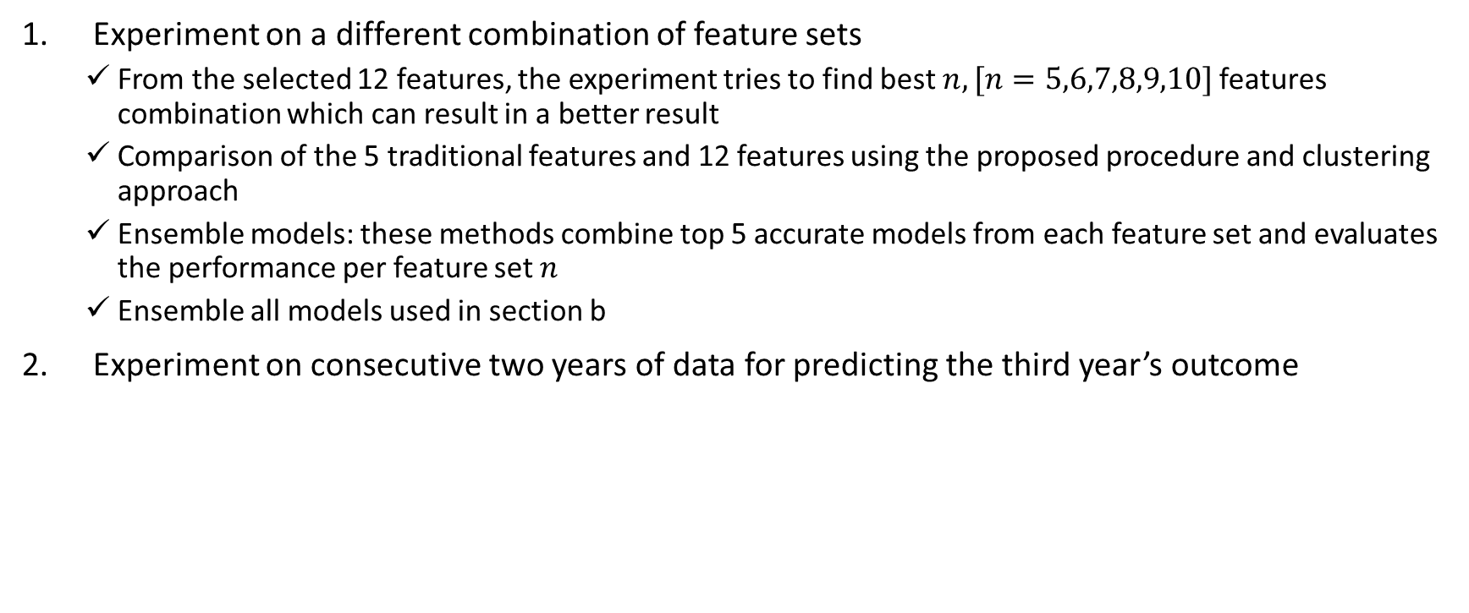
Content
Experiment on a different combination of feature sets
From the selected 12 features, the experiment tries to find best $n, [n=5,6,7,8,9,10]$ features combination which can result in a better result
Comparison of the 5 traditional features and 12 features using the proposed procedure and clustering approach
Ensemble models: these methods combine top 5 accurate models from each feature set and evaluates the performance per feature set $n$
Ensemble all models used in section b
Experiment on consecutive two years of data for predicting the third year’s outcome

Slide 4
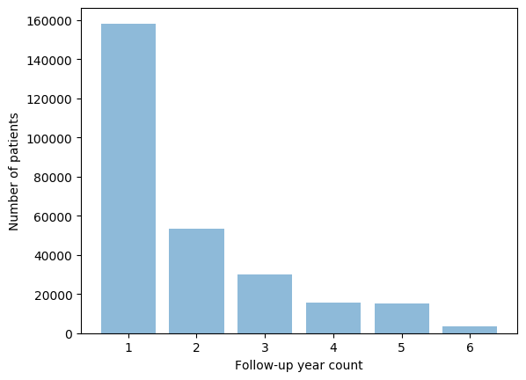
Dataset
This study considers only patients with
at least 2 years of continuous annual medical check-up during the follow-up period
not previously diagnosed with Diabetes
No missing features Instances
The total number of instances after the preprocessing is 169,024
Number of patients: 80,692
Male count: 48,912
Female count: 31,780
The mean age: 41.17 ± 9.95
Region of interest
 | Training set | Testing set
Diabetes | 20,315 | 200
Prediabetes | 20,315 | 200
Normal | 20,315 | 200

Slide 5
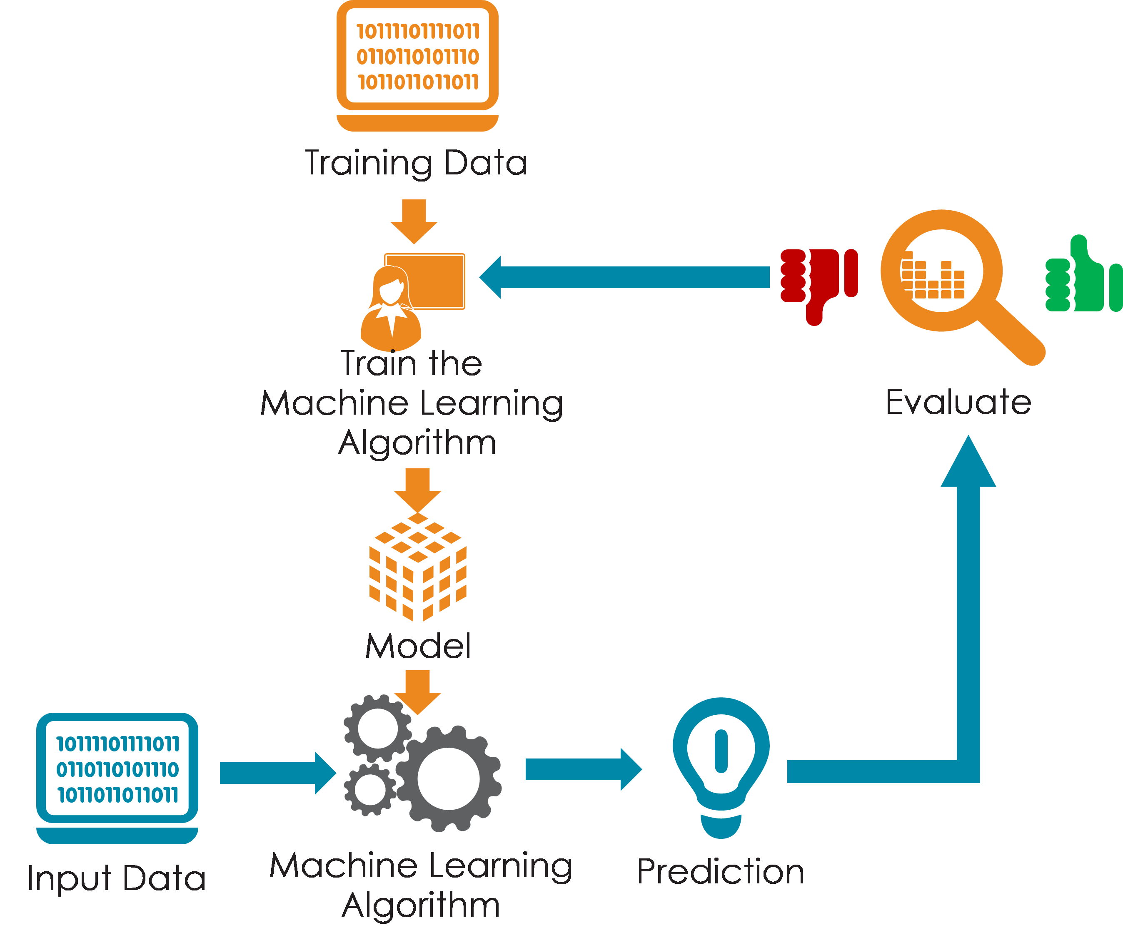
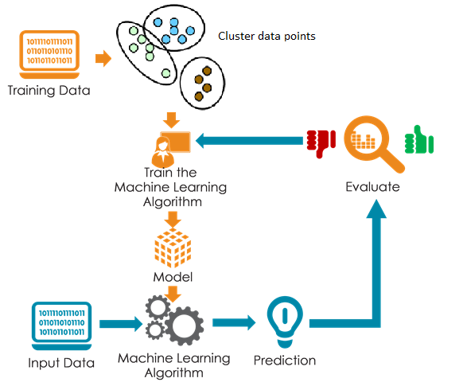
2. Comparison of ML flow with Clustering vs with out clustering approach
In these experiments, the K-means clustering algorithm used to cluster the data points and generate labels for each datum
The generated cluster label is used as a new feature and added to the feature set
a) ML flow
b) ML flow with clustering

Slide 6
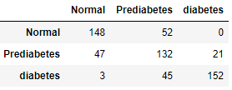
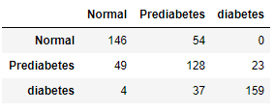
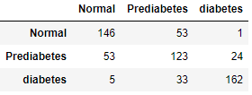
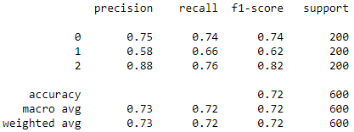
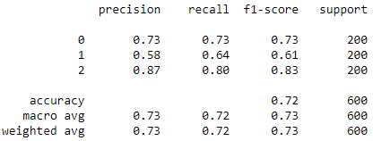
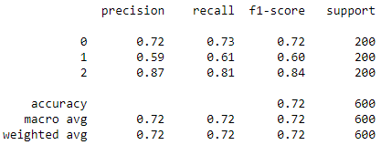
2. Comparison of ML flow with Clustering vs with out clustering approach
5 Features (Traditional features)
 | Training set | Testing set
Diabetes | 22,003 | 200
Prediabetes | 22,003 | 200
Normal | 22,003 | 200
RF
Accuracy = 0.72
XGBoost
Accuracy = 0.721
SVM
Accuracy = 0.718

Slide 7
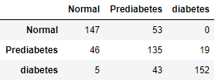
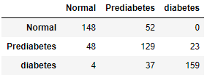
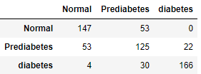
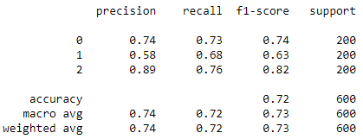
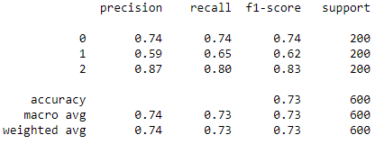
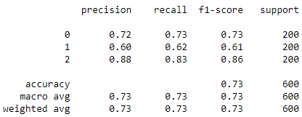
2. Comparison of ML flow with Clustering vs with out clustering approach
5 Features (Traditional features) with clustering
RF
Accuracy = 0.723
XGBoost
Accuracy = 0.726
SVM
Accuracy = 0.73

Slide 8
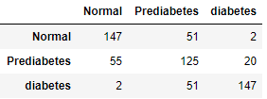
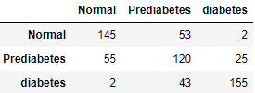
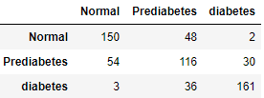
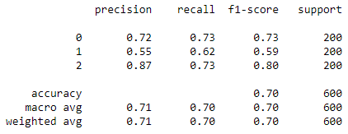
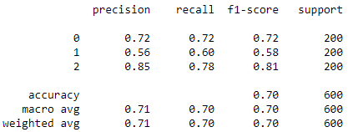
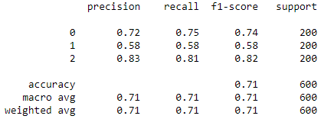
2. Comparison of ML flow with Clustering vs with out clustering approach
12 Features
 | Training set | Testing set
Diabetes | 20,315 | 200
Prediabetes | 20,315 | 200
Normal | 20,315 | 200
RF
Accuracy = 0.698
XGBoost
Accuracy = 0.7
SVM
Accuracy = 0.711

Slide 9
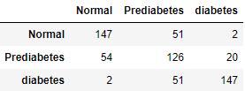
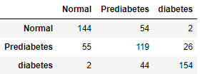
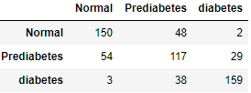
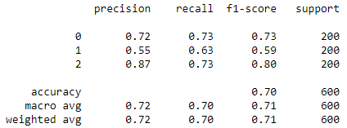
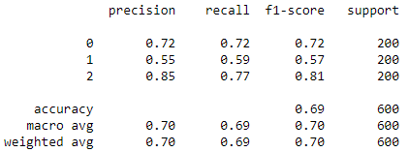
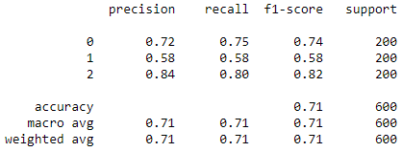
2. Comparison of ML flow with Clustering vs with out clustering approach
12 Features with clustering
RF
Accuracy = 0.7
XGBoost
Accuracy = 0.695
SVM
Accuracy = 0.71

Slide 10
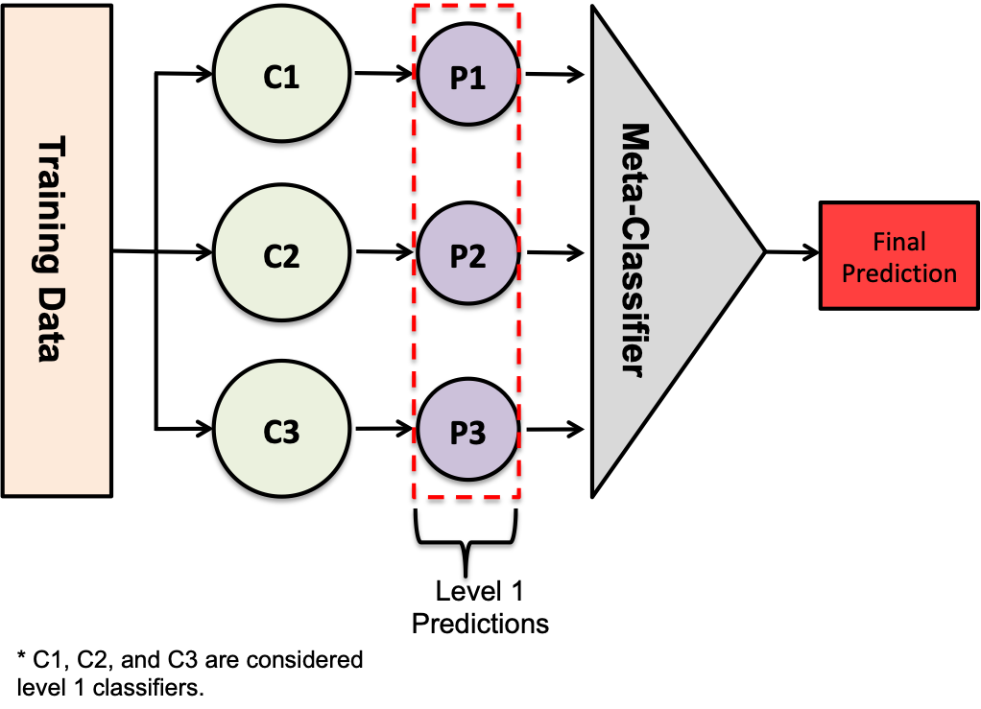
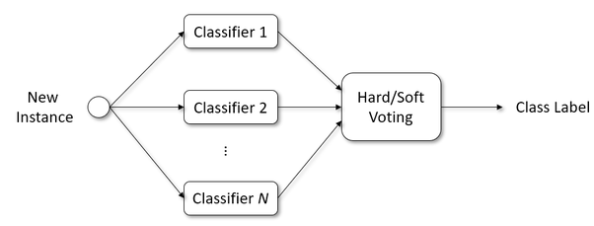
3. Ensemble Approach
Stacking classifier
In this sub section, top 5 more accurate models from each feature sets are selected and ensembled using
Stacking classifier
Soft voting classifier
Hard voting classifier
The algorithms used in this experiment are
RF
SVM
XGBoost
A total of 15 models are used for each ensemble technique
Voting classifer
 | Training set | Testing set
Diabetes | 20,315 | 200
Prediabetes | 20,315 | 200
Normal | 20,315 | 200

Slide 11
3. Ensemble Approach – not done

Slide 12
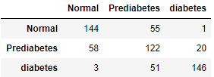
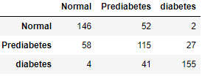
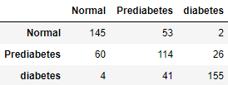
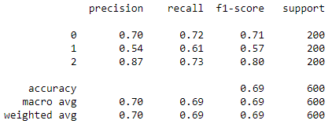
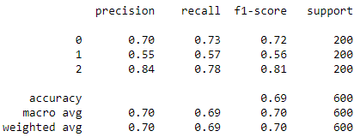
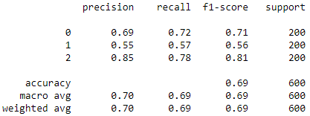
3. Ensemble Approach
5 Features Combination
 | Features
1 | FPG, HbA1c, Physical Activity, Family History, Sex
2 | FPG, HbA1c, Smoking, Physical Activity, Sex
3 | FPG, HbA1c, Drinking, Family History, Sex
4 | FPG, HbA1c, Triglyceride, Physical Activity, Sex
5 | FPG, HbA1c, Uric Acid, Physical Activity, Sex
Stacking Classifier
accuracy 0.686
Hard Voting Classifier
accuracy 0.693
Soft Voting Classifier
accuracy 0.69

Slide 13
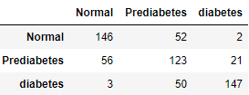
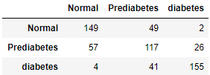
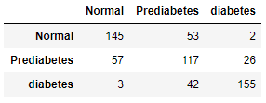
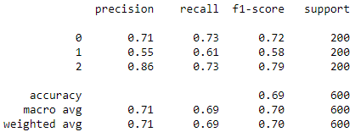
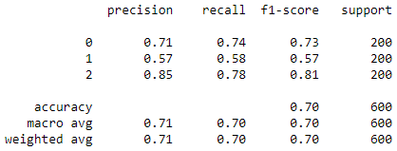
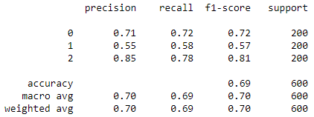
3. Ensemble Approach
6 Features Combination
 | Features
1 | FPG, HbA1c, Uric acid, Smoking, Physical Activity, Sex
2 | FPG, HbA1c, Uric acid, Drinking, Physical Activity, Sex
3 | FPG, HbA1c, Smoking, Family History, Sex, Age
4 | FPG, HbA1c, BMI, Smoking, Physical Activity, Sex
5 | FPG, HbA1c, Triglyceride, Uric acid, Physical Activity, Sex
Stacking Classifier
accuracy 0.693
Hard Voting Classifier
accuracy 0.701
Soft Voting Classifier
accuracy 0.695

Slide 14
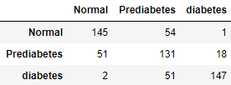
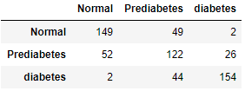
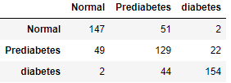
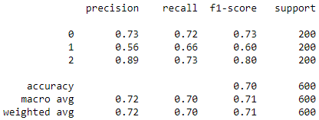
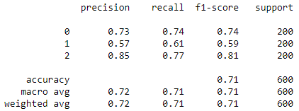
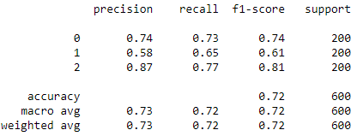
3. Ensemble Approach
7 Features Combination
 | Features
1 | FPG, HbA1c, Uric acid, Smoking, Physical Activity, Sex
2 | FPG, HbA1c, Uric acid, Drinking, Physical Activity, Sex
3 | FPG, HbA1c, Smoking, Family History, Sex, Age
4 | FPG, HbA1c, BMI, Smoking, Physical Activity, Sex
5 | FPG, HbA1c, Triglyceride, Uric acid, Physical Activity, Sex
Stacking Classifier
accuracy 0.705
Hard Voting Classifier
accuracy 0.708
Soft Voting Classifier
accuracy 0.716

Slide 15
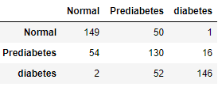





3. Ensemble Approach
8 Features Combination
 | Features
1 | FPG, HbA1c, Triglyceride, BMI, Uric acid, smoking, Sex, Age
2 | FPG, HbA1c, Triglyceride, BMI, GTP gamma, smoking, Sex, Age
3 | FPG, HbA1c, Triglyceride, BMI, GTP gamma, Family history, Sex, Age
4 | FPG, HbA1c, Triglyceride, BMI, Uric acid, Family history, Sex, Age
5 | FPG, HbA1c, BMI, GTP gamma, Uric acid, smoking, Family history, Age
Stacking Classifier
accuracy 0.708
Hard Voting Classifier
accuracy 0.705
Soft Voting Classifier
accuracy 0.708

Slide 16






3. Ensemble Approach
9 Features Combination
 | Features
1 | FPG, HbA1c, Triglyceride, BMI, Uric acid, smoking, Physical activity, Sex, Age
2 | FPG, HbA1c, Triglyceride, BMI, GTP gamma, smoking, Family history, Sex, Age
3 | FPG, HbA1c, Triglyceride, BMI, GTP gamma, Uric acid, smoking, Family history, Age
4 | FPG, HbA1c, BMI, GTP gamma, smoking, Drinking, Family history, Sex, Age
5 | FPG, HbA1c, BMI, GTP gamma, Uric acid, Physical activity, Family history, Sex, Age
Stacking Classifier
accuracy 0.696
Hard Voting Classifier
accuracy 0.703
Soft Voting Classifier
accuracy 0.708

Slide 17






3. Ensemble Approach
10 Features Combination
 | Features
1 | FPG, HbA1c, Triglyceride, BMI, GTP gamma, Uric acid, smoking, Family history, Sex, Age
2 | FPG, HbA1c, BMI, GTP gamma, smoking, Drinking, Physical activity, Family history, Sex, Age
3 | FPG, HbA1c, Triglyceride, BMI, GTP gamma, Uric acid, smoking, Drinking, Sex, Age
4 | FPG, HbA1c, Triglyceride, BMI, GTP gamma, Uric acid, smoking, Physical activity, Sex, Age
5 | FPG, HbA1c, Triglyceride, BMI, Uric acid, smoking, Physical activity, Family history, Sex, Age
Stacking Classifier
accuracy 0.698
Hard Voting Classifier
accuracy 0.706
Soft Voting Classifier
accuracy 0.71

Slide 18






3. Ensemble Approach
12 Features
Three algorithms (SVM, RF, and XGBoost) are used to generate the constituent models of the final ensemble classifier
Stacking Classifier
accuracy 0.698
Hard Voting Classifier
accuracy 0.703
Soft Voting Classifier
accuracy 0.71

Slide 19






3. Ensemble Approach
5 Features (Traditional features)
Three algorithms (SVM, RF, and XGBoost) are used to generate the constituent models of the final ensemble classifier
Stacking Classifier
accuracy 0.72
Hard Voting Classifier
accuracy 0.716
Soft Voting Classifier
accuracy 0.723

Slide 20






4. Ensemble of all the models
In this section, all the models used in the previous sections are ensembled to generate final classifier
Total number of Models is 96
15 Models for each of the feature set group (5,6,7,8,9,10 features)
3 for the traditional features and
3 for the 12 feature set
Stacking Classifier
accuracy 0.693
Hard Voting Classifier
accuracy 0.706
Soft Voting Classifier
accuracy 0.711

Slide 21

5. Two years data for predicting the third year status
In this experiment the features at $F\left(t−2\right)$, $F\left(t−1\right)$and the difference $F\left(t−2\right)−F(t−1)$ are used to predict the status of the person at the third year (t)
12 features set experiment class distribution:
diabetes=597 ,
prediabetes = 9,103 ,
normal=17,951
Training and testing data size for each class is 9,053 and 50 respectively
Region of interest

Slide 22






5. Two years data for predicting the third year status
12 Features experiment
RF
Accuracy = 0.733
XGBoost
Accuracy = 0.713
SVM
Accuracy = 0.753

Slide 23






5. Two years data for predicting the third year status
12 Features experiment with clustering
In this experiment, clustering label added to the feature space using K-means clustering algorithm.
The K-means clustering algorithm used to cluster whole dataset into three groups and generate label for each data point
RF
Accuracy = 0.74
XGBoost
Accuracy = 0.713
SVM
Accuracy = 0.753

Slide 24






5. Two years data for predicting the third year status
5 traditional features set experiment Class distribution
diabetes= 726,
prediabetes = 10,492 ,
normal= 19,694
Training and testing data size for each class is 10,442 and 50 respectively
RF
Accuracy = 0.74
XGBoost
Accuracy = 0.726
SVM
Accuracy = 0.726

Slide 25






5. Two years data for predicting the third year status
5 traditional features experiment with clustering
In this experiment, clustering label added to the feature space using K-means clustering algorithm.
The K-means clustering algorithm used to cluster whole dataset into three groups and generate label for each data point
RF
Accuracy = 0.733
XGBoost
Accuracy = 0.726
SVM
Accuracy = 0.726

